Slide 1


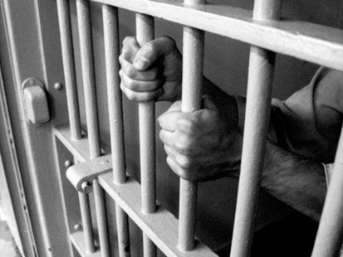
Submitted by:
Sameep Periwal (12ESKCS099)
Shumayala Sabbag(12ESKCS108)
Uday Chopra(12ESKCS120)
Ritwick Tak(12ESKCS097)
PRISON MANAGEMENT
SYSTEM

Slide 2
CONTENTS
INTRODUCTION
EXISTING SYSTEM
PROPOSED SYSTEM
ADVANTAGES
HARDWARE REQUIREMENTS
SOFTWARE REQUIRMENTS
MODULE DESCRIPTION
DATA FLOW DIAGRAM
TABLES
IMPLEMENTATION
CONCLUSION
FUTURE ENHANCEMENTS
REFERENCES

Slide 3
ABSTRACT
Desktop application exclusively for administrators in the prison.
Gives a clear idea of the Prison and its details and information about the prisoners.
Helps to view and update prisoners info, guard info and also helps in scheduling work(job) for each prisoner.
Used to keep a feedback of each prisoner by administrators.

Slide 4
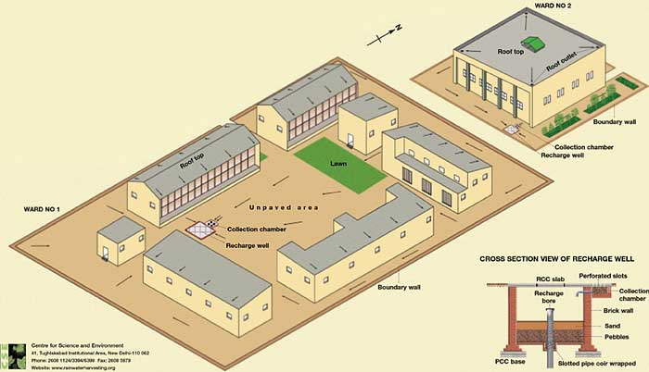
EXISTING SYSTEM
Let us consider the case of TIHAR PRISON one of biggest prisons in India with 12000 inmates.
Includes info about prisoners, their crime and lodging pattern. It also records, tracks and monitors the movement of prisoners.
Doesn’t have the provision for head to schedule prisoners and guard’s job(work assignment).
No provision to keep feedback regarding the performance of the prisoners.

Slide 5
PROPOSED SYSTEM
We have the database of prisoners, guards and administrator.
Administrator can schedule jobs for prisoners and guards.
Through feedback management guards can records the performance of prisoners.
Production overview can be viewed.
Administrator can have and update all the details of prisoners and guards.

Slide 6
ADVANTAGES OF PROPOSED SYSTEM
Improvements and reforms can be taken in a swifter and efficient manner.
Alertness of guards gets increased since they need to provide constant feedback to the prison administration .
Prison inmates can serve their jail period by serving the society.
Production summary can be viewed

Slide 7
HARDWARE REQUIREMENTS
Pentium processor : 1.2 GHZ
RAM Capacity : 500 MB (min)
Hard Disk : 20GB
CD-ROM Drive : 32 HZ
Keyboard : Standard keyboard.
Mouse : Optical
Monitor : 15’’ Color Monitor

Slide 8
SOFTWARE REQUIREMENTS
Programming Language : Java
Technologies : Andriod V4.2.2
Database Connectivity : JDBC
Java Version : JDK 8
Backend Database : SQLite.
Operating System : Windows XP/2000.
Web Server : Tomcat 6.0

Slide 9
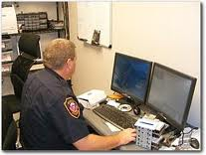
1.ADMINISTRATOR
This module has access to all other modules. In other words, it administers all other module or parts of the software.
A login and password is provided to this module to ensure its security.
The details of the administrator helps to identify the top management in a prison.

Slide 10

2.SUPERVISOR
Supervisor has all the functions of the guard like viewing work schedule, adding prisoner feedback ,viewing prisoner details etc.
Additional provision is the maintenance of purchase - sale info.
It can add details of purchase and info like amount of item purchased/sold and calculate net profit and loss.

Slide 11

3.PRISONER
This module includes details of each prisoner. Prisoner management module helps to view prisoner information and update the current information.
The information is regarding their personal details such as name, address, crime, date duration of the imprisonment, etc.
Updation includes insertion and deletion of information provided.

Slide 12
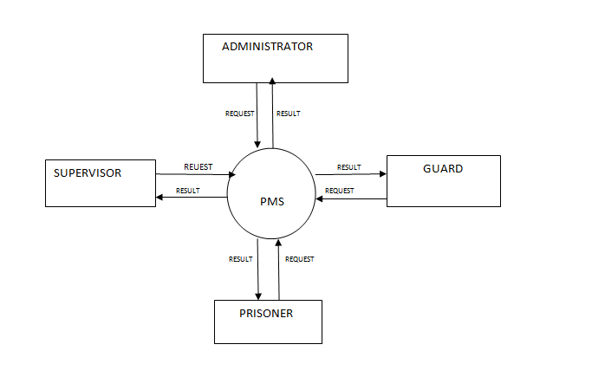
DATA FLOW DIAGRAM
LEVEL 0 DFD

Slide 13
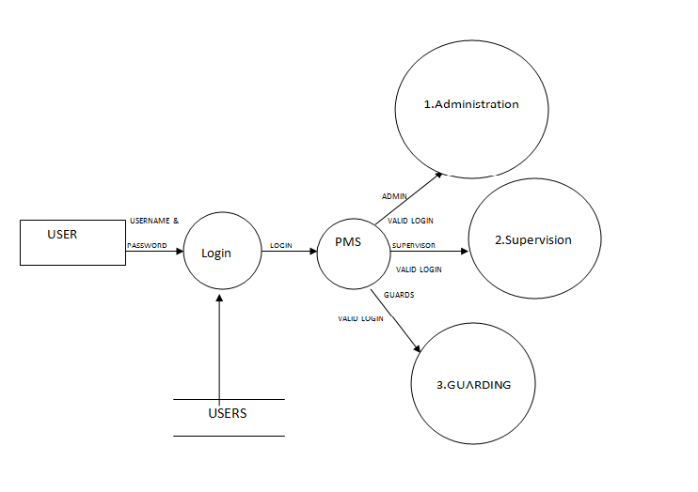
LEVEL 1 DFD

Slide 14
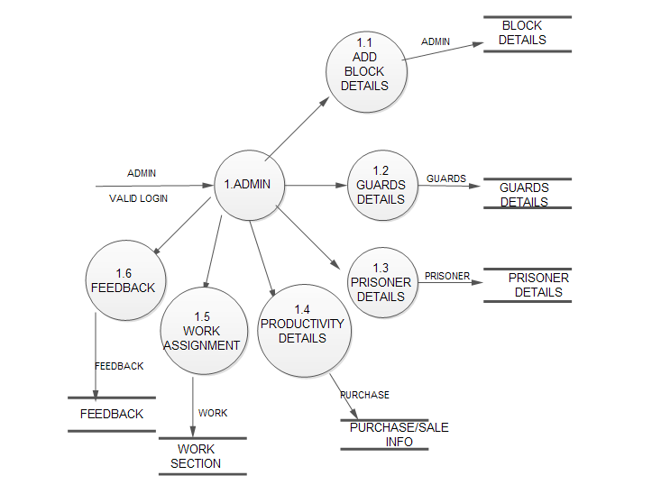
LEVEL 2 DFD:ADMINISTRATOR

Slide 15
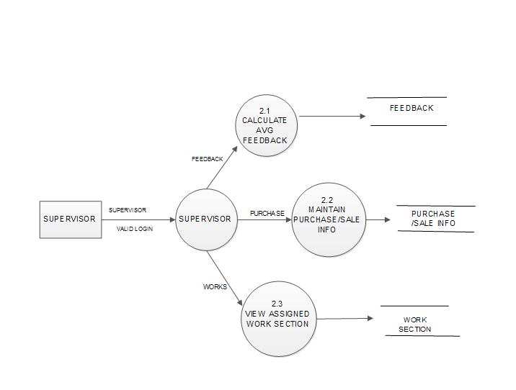
LEVEL 2 DFD:SUPERVISOR

Slide 16
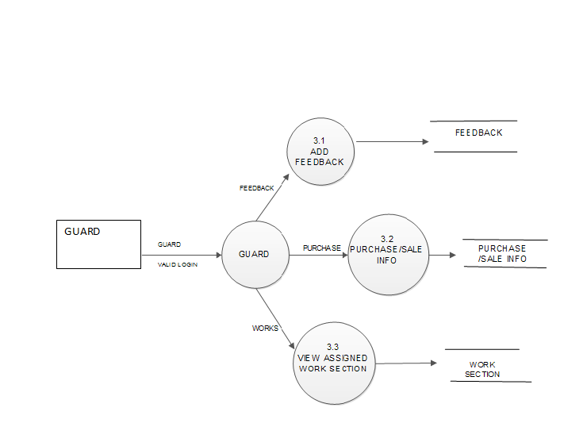
LEVEL 2 DFD:GUARD

Slide 17
TABLES
Login Table:
Login Table:
Login Table:
Login Table:
Serial Number | Field name | Type of field | Remark
1 | Username | Varchar(15) | Primary key
2 | Password | Number(10) | --
Serial Number | Field name | Type of field | Remark
1 | Username | Varchar(15) | Primary key
2 | Password | Number(10) | --
Serial Number | Field name | Type of field | Remark
1 | Username | Varchar(15) | Primary key
2 | Password | Number(10) | --
Serial Number | Field name | Type of field | Remark
1 | Username | Varchar(15) | Primary key
2 | Password | Number(10) | --
2.Nominal Roll Register:
2.Nominal Roll Register:
2.Nominal Roll Register:
Serial number | Fieldname | Type of field | Remark
1 | Prisoner id | Number(1000) | Primary key
2 | Case id | Number(1000) | Foreign key
3 | Name | Varchar(15) | No special characters allowed
4 | Gender | Varchar(1) | M/F
5 | Type | Varchar(15) | Duration specific/ life term
6 | Duration of sentence | Number(100000) | No. of days
7 | Height | Number(500) | In cms
8 | Criminal Snaps | <img object> | --
9 | Status | Number(1) | 1.in jail 2.on parole 3.released 4. dead
Serial number | Fieldname | Type of field | Remark
1 | Prisoner id | Number(1000) | Primary key
2 | Case id | Number(1000) | Foreign key
3 | Name | Varchar(15) | No special characters allowed
4 | Gender | Varchar(1) | M/F
5 | Type | Varchar(15) | Duration specific/ life term
6 | Duration of sentence | Number(100000) | No. of days
7 | Height | Number(500) | In cms
8 | Criminal Snaps | <img object> | --
9 | Status | Number(1) | 1.in jail 2.on parole 3.released 4. dead

Slide 18
3. Case Register:
Serial number | Field name | Type of variable | Remark
1 | Case id | Number(1000) | Primary key
2 | description | varchar(15) | Special characters not allowed
3 | type | Number(1) | 1.murder 2.theft 3.forgery 4.counterfeiting
4.Parole Register:
Serial number | Field name | Type of variable | Remarks
1 | Prisoner id | Number(1000) | Primary key
2 | Address of residence | Varchar(15) | Special keys not allowed
3 | Entry date | Date | --
4 | Exit date | Date | --
5 | Remand frequency days | Number(1000) | Should visit jail for remand
6 | Last frequency days | Number(1000) | T/F
7 | Last remand visit status | Varchar(1) | --
8 | Last visited on | Date | --

Slide 19
IMPLEMENTATION

Slide 20
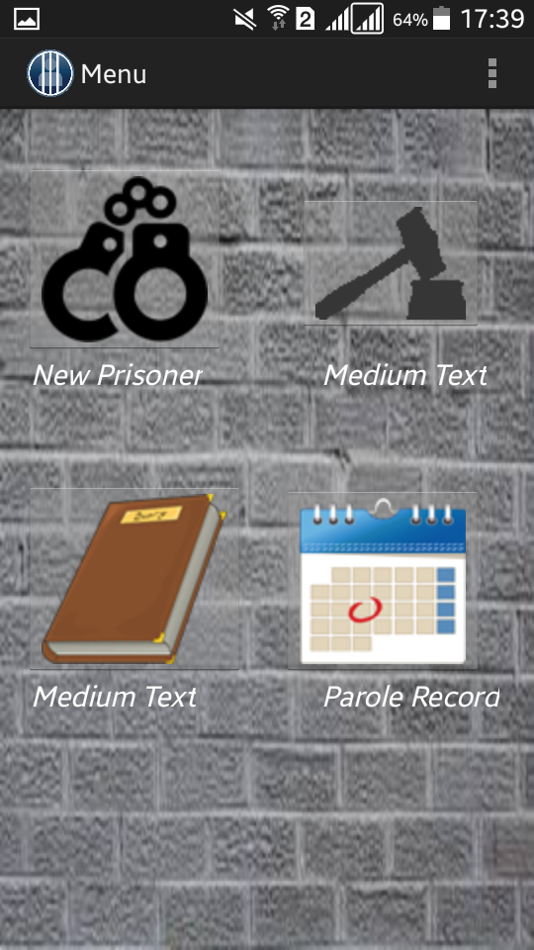

Slide 21
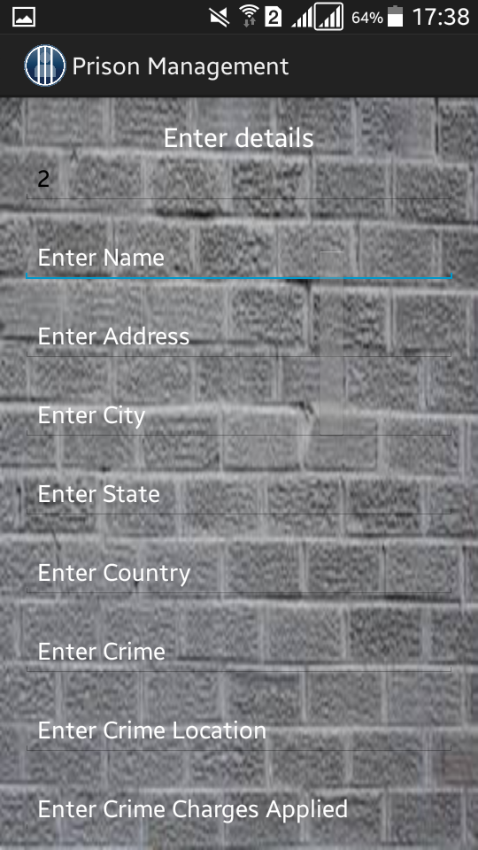

Slide 22
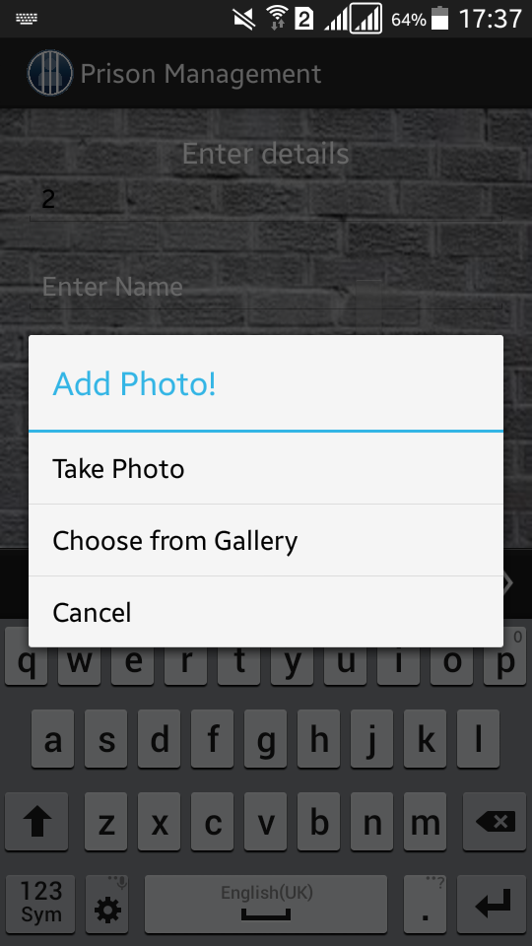

Slide 23
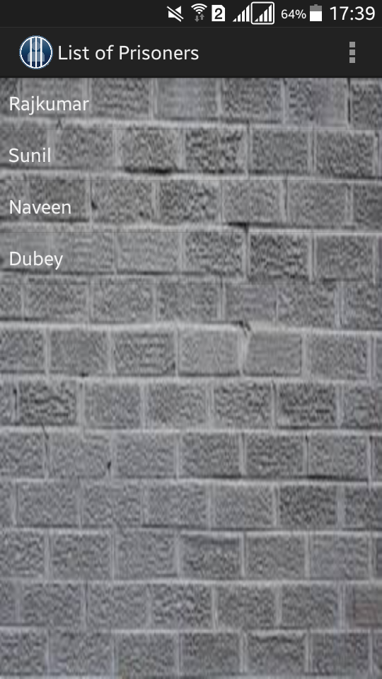

Slide 24
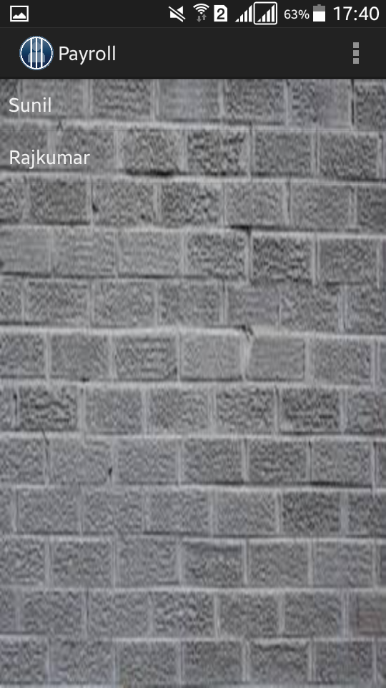

Slide 25
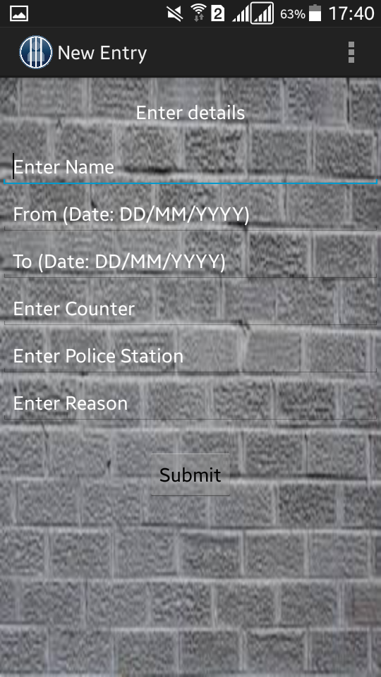

Slide 26
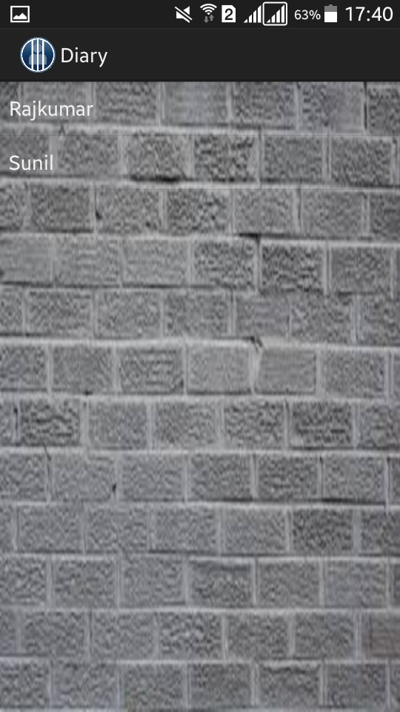

Slide 27
CONCLUSION
“As the technology is growing day by day, hour by hour very fast we have to use those growing technologies to the best.”
Our system provides different services like easy access to users, efficient management ,clear productivity and feedback summary.

Slide 28
FUTURE ENHANCEMENTS
To provide users a platform where they could implement technology.
To add more location specifications for the better Security of Prisoners.
Update the system with the advancement of technology.

Slide 29
REFERENCES
Elmsri and Navethe, “Fundamentals of Database Systems”
Rajib Mall, “Fundamentals of Software Engineering”
Robert Vieira, “Beginning SQL Server Programming”
Herbert Schildt,”Java The Complete Reference”, 8th Edition.
Patrick Keegan, “NetBeans IDE Field Guide”.

Slide 30
WEB SITES
http://www.oracle.com/index.html
https://w3schools.com
http://www.mysql.com
http://www.wikipedia.org/

Slide 31
Thank You

